Slide 1
AWS for the .NET Developer

Slide 2

Bart Kooijmans
Software Engineer at Team Rockstars IT
Working with .NET since 2007
Working with Azure since 2015
Working with AWS since 2021
https://github.com/Bartolomew85

Slide 3
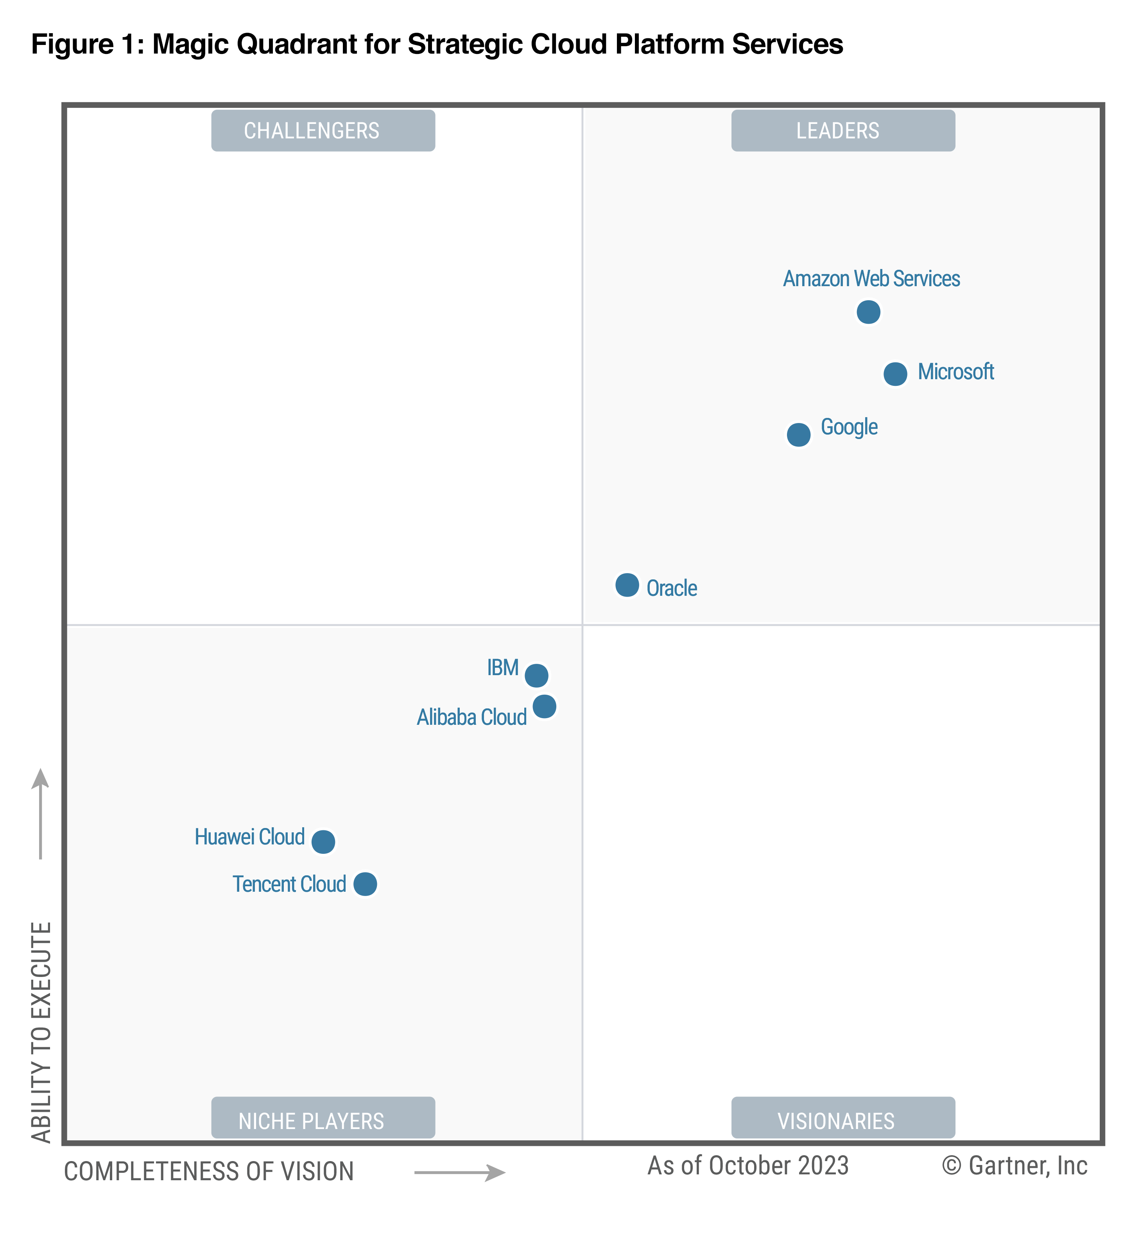
What is AWS?
Amazon Web Services
2002 – 2006: webservice, database, storage, compute
(Azure came in 2008)
Now 200+ products and services
Python, Java, Javascript and .NET
https://aws.amazon.com

Slide 4
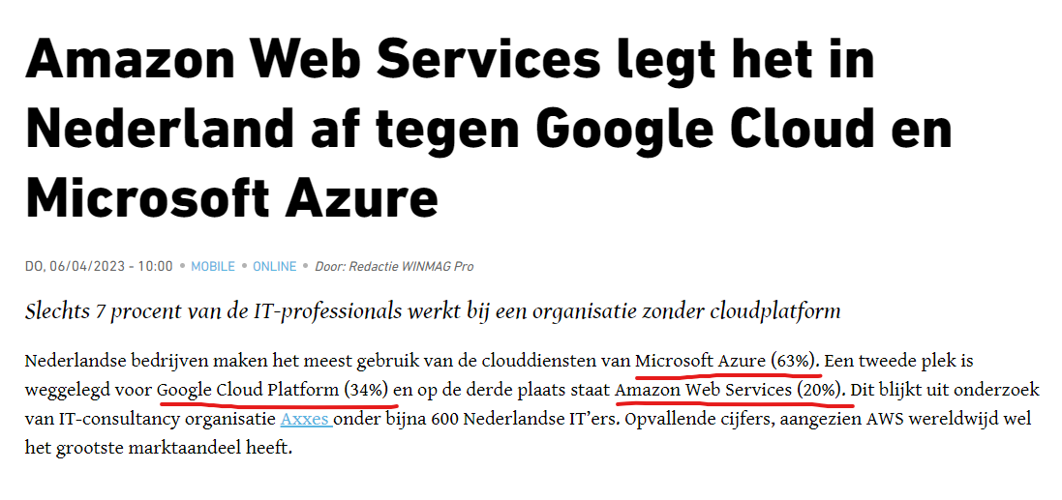
https://www.winmagpro.nl/amazon-web-services-legt-het-in-nederland-af-tegen-google-cloud-en-microsoft-azure

Slide 5
AWS to Azure services comparison
Azure | AWS
Azure Function | AWS Lambda
Azure Bicep / ARM | AWS CDK / CloudFormation
Azure VM | AWS EC2
Azure App Service | AWS Beanstalk
Azure Blob Storage | AWS S3
Azure Table Storage | AWS DynamoDB
Azure Queue Storage | AWS SQS
Azure Service Bus | AWS SNS
Azure Container Instance | AWS ECS/Fargate
https://learn.microsoft.com/en-us/Azure/architecture/AWS-professional/services

Slide 6
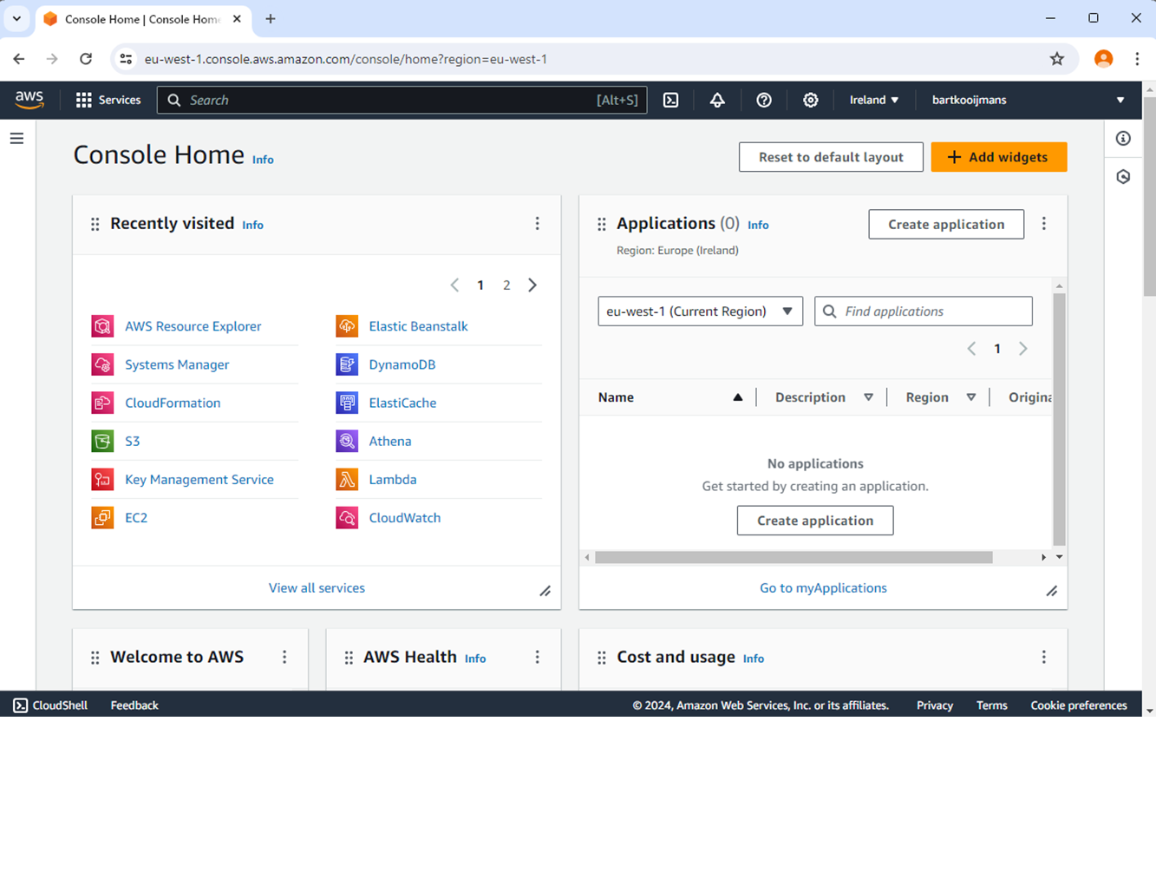
AWS Console
https://aws.amazon.com/console/

Slide 7
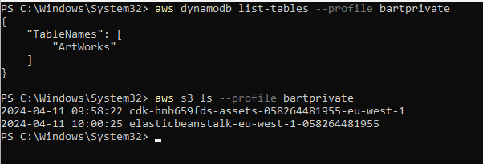
AWS CLI

Slide 8
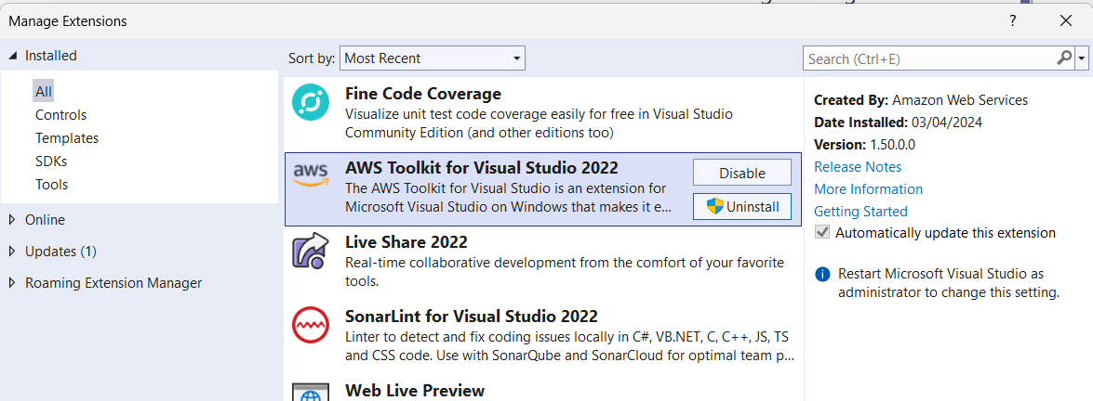
Visual Studio Extensions

Slide 9

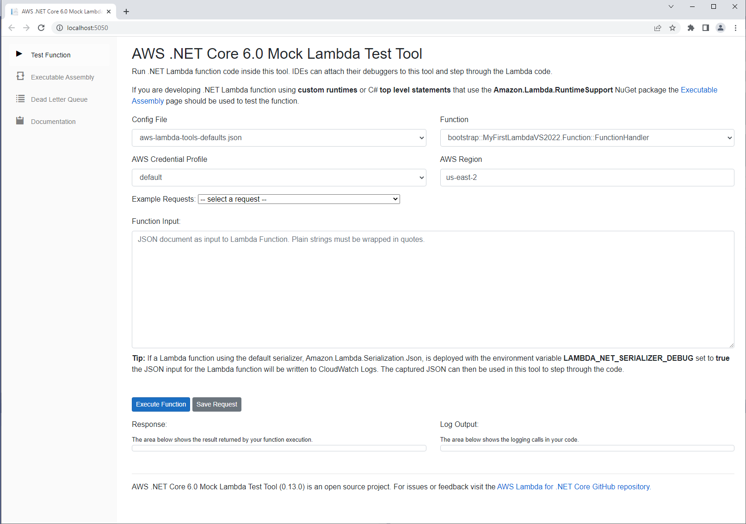
https://github.com/AWS/AWS-lambda-dotnet/tree/master/Tools/LambdaTestTool

Slide 10
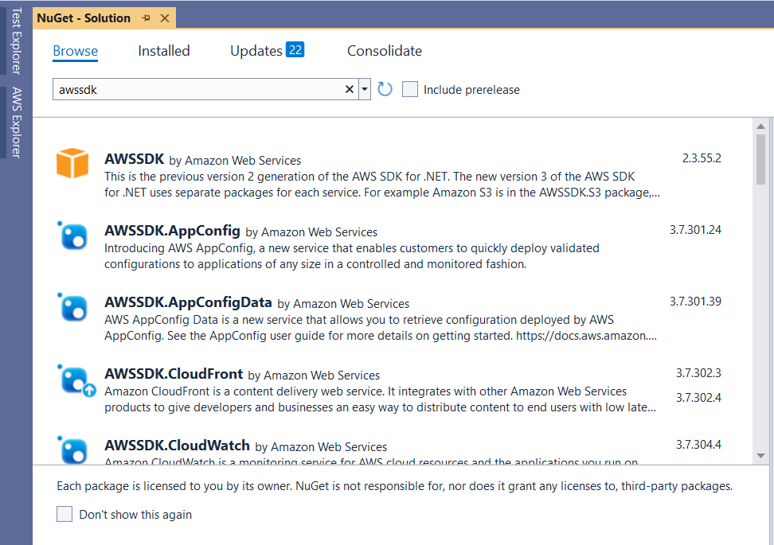
Nuget: AWSSDK

Slide 11
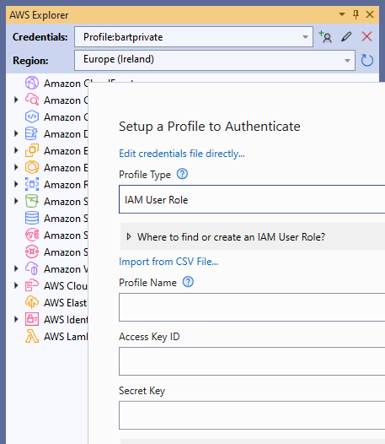
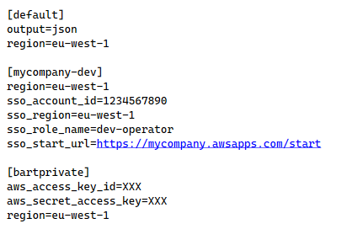
First setup credentials
%userprofile%\.aws\credentials :

Slide 12
Demo
ASP.NET Core Web App
hosted in AWS Beanstalk
DynamoDB database
Lambda processor with SQS queue trigger
Cloudwatch for logging

Slide 13
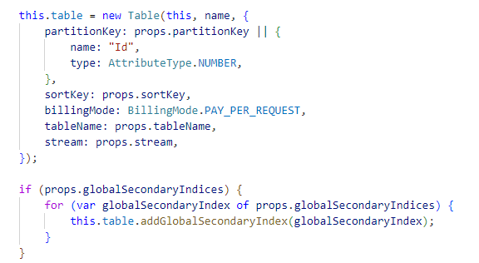
CDK: Cloud Development Kit

Slide 14
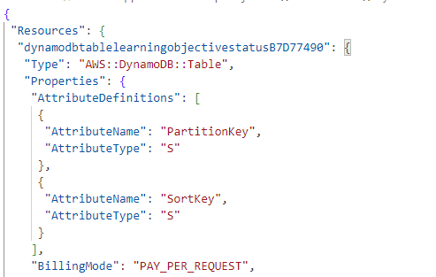
CloudFormation: Infrastructure as Code

Slide 15
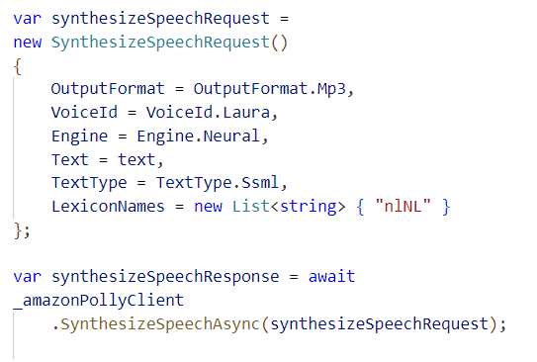

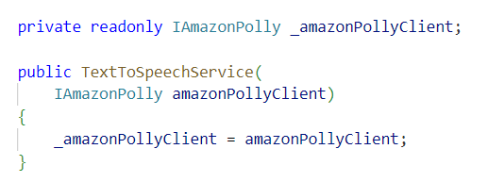
Nuget: AWSSDK.Polly
Dependency Injection
Call AWS

Slide 16
Conclusion
Lots of Nuget packages
Great support for .Net and Visual Studio
Big cloud provider with international reach

